Slide 1
Internship

Slide 2
Introduction to Company
Performant, an ed-tech startup, has carved a niche in the market through meticulous market analysis. We specialize in providing tailored and cost-effective live and recorded training courses and workshops, catering to students, enthusiasts, aspiring entrepreneurs, and professionals. Our comprehensive programs cover basics to advanced concepts, ensuring a well-rounded learning experience. Additionally, Performant extends qualitative and quantitative support to businesses, focusing on strategic methods for widespread popularity across Indian campuses. With a vision for premium quality services, our team strives to enhance brand reputation through effective digital marketing solutions, emphasizing smarter marketing through insightful innovation. Contact us for impactful and measurable digital marketing services that boost sales and foster brand loyalty.

Slide 3
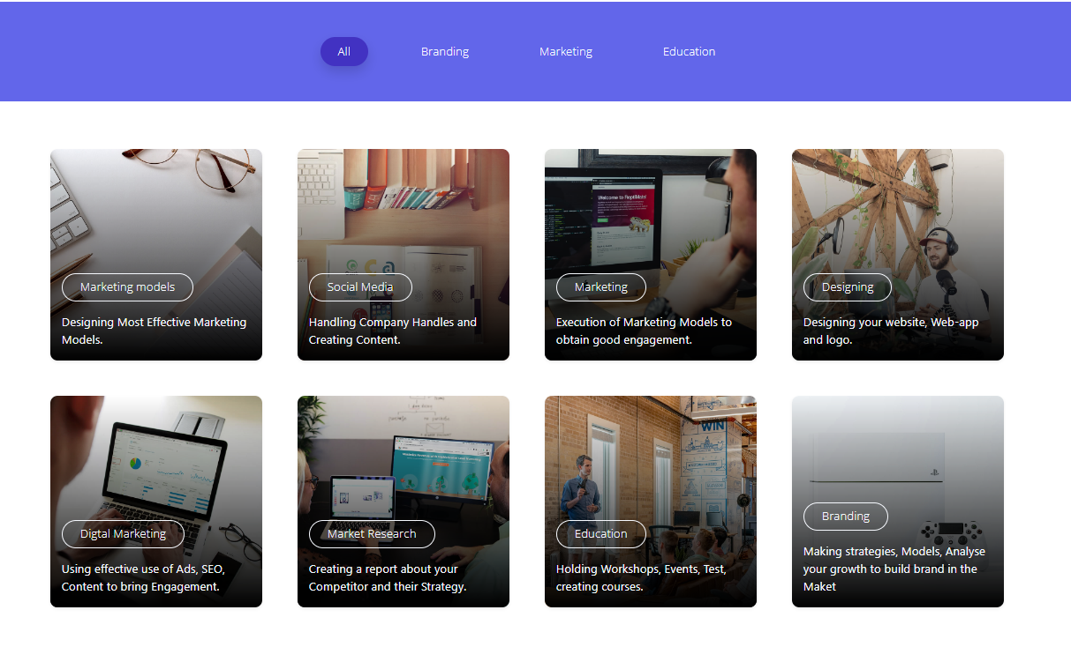

Slide 4
Roles and Responsibilities
I worked as AI intern in Performant – an edtech company.
I was told to Engage in team-based projects and tasks.
I was tasked with analyzing the company's surroundings and identifying a problem statement. My goal was to use this information to develop a solution for the identified problem.
As an AI intern at Performant, I analyzed the company's environment, identified a key problem statement, and developed a solution within a 4-week timeframe. My role also involved contributing to AI model development

Slide 5
FACE RECOGNITION & ATTENDANCE SYSTEM

Slide 6
INTRODUCTION to PROJECT
Project Objective: Develop a face recognition-based attendance monitoring system for 1institutions.
Purpose: Enhance and upgrade the existing attendance system for increased efficiency and effectiveness.
Challenges in Current System: Ambiguity, inaccuracies, and inefficiencies in the old attendance system.

Slide 7
Technology Utilized: Face recognition system, leveraging the unique traits of the human face for accurate identification.
Key Feature: Human face as a natural trait for unique identification, minimizing possibilities of deviation or duplication.
Implementation Steps:
Creation of comprehensive face databases.
Data feeding into the recognizer algorithm.
Face comparison during attendance sessions against the database.
Automatic recording of attendance for identified individuals.
Storage of attendance information in an Excel sheet.

Slide 8
End-of-Day Process: Compilation of attendance data into an Excel sheet.
Automated Reporting: Mailing of the Excel sheet containing attendance information to respective faculty members.
Significance: Modernizes the attendance monitoring process, minimizes errors, and ensures accuracy through automation and face recognition technology.

Slide 9
Potential Benefits and Advantages
Accuracy and Elimination of Proxy Attendance: Face recognition ensures precise identification, significantly reducing the likelihood of proxy attendance or any form of manipulation. Each individual's face is unique, providing a reliable means of verification.
Real-time Monitoring: The system allows for real-time monitoring of attendance, providing instant updates to administrators. This quick access to attendance data enables prompt decision-making and intervention when necessary.
Time and Resource Savings: Automation through face recognition saves valuable time for both students and faculty. The streamlined process eliminates the need for manual data entry and the associated paperwork, optimizing resource allocation.

Slide 10
User-Friendly Experience: The face recognition attendance system offers a user-friendly experience for both administrators and students. There's no need for physical cards or manual sign-ins, making the attendance process seamless and convenient.
Integration with Modern Technologies: Choosing a face recognition system aligns with the integration of modern technologies in educational institutions. It enhances the institution's image as forward-thinking and technologically advanced.
Security and Privacy: Face recognition, when implemented responsibly, ensures a secure and private means of identification. Biometric data is unique to each individual, and modern systems prioritize data protection and privacy.

Slide 11
Face Recognition Technology Overview
Face recognition technology is a biometric method used to identify and verify individuals based on their facial features. It leverages advanced algorithms and machine learning techniques to analyze and match unique facial patterns. Key components of face recognition technology include:

Slide 12
Facial Detection: The system locates and identifies faces within an image or video stream, often using key facial landmarks.
Feature Extraction: Facial features such as the distance between eyes, nose shape, and jawline are extracted to create a unique facial signature.
Database Comparison: The extracted facial signature is compared with pre-existing data in a database to identify or verify the individual.
Machine Learning: Face recognition systems often use machine learning algorithms to improve accuracy over time, learning from a continuously expanding dataset.

Slide 13
Existing Attendance Systems and Limitations
Manual Sign-in Sheets:
Limitations: Prone to errors, time-consuming, and can be manipulated through proxy attendance.
Barcode/RFID Cards:
Limitations: Cards can be lost or shared, leading to inaccuracies. Additionally, the process requires physical contact, which might be inconvenient.
Biometric Systems (Fingerprint, Iris Scan):
Limitations: These systems may face hygiene concerns, and some individuals might be uncomfortable with physical contact. Accuracy can also be affected by factors like dirty fingers or poor lighting conditions.

Slide 14
Traditional Face Recognition Systems:
Limitations: Earlier face recognition systems faced challenges in accuracy, especially under varying lighting conditions, and were susceptible to false positives or negatives.
Manual Digital Entry:
Limitations: While more advanced than traditional manual methods, manual digital entry systems still depend on user input, allowing for potential errors and manipulation.
Voice Recognition:
Limitations: Limited accuracy in noisy environments, and voice changes due to illness or other factors may impact reliability.

Slide 15
Mobile Apps for Attendance:
Limitations: Dependent on students carrying and using smartphones, which might not be universal. Also susceptible to sharing login credentials.
Existing Face Recognition Systems:
Limitations: Earlier systems faced challenges in accuracy, especially with variations in facial expressions, angles, or aging. Privacy concerns and ethical considerations also need to be addressed.

Slide 16
Significance of Face Recognition Attendance System
Precision in Attendance Tracking:
The face recognition system ensures accurate and reliable attendance tracking by uniquely identifying each individual based on facial features. This minimizes the possibility of errors and eliminates the potential for proxy attendance.
Efficiency and Time Savings:
Automating the attendance process through face recognition significantly reduces administrative tasks associated with manual data entry or physical sign-in sheets. This efficiency leads to time savings for both students and faculty.
Enhanced Security:
Face recognition adds a layer of security by relying on unique biometric data. It reduces the risk of identity fraud or unauthorized access, providing a more secure attendance tracking method compared to traditional systems.

Slide 17
User-Friendly Experience:
The system offers a seamless and user-friendly experience for both students and faculty. There's no need for physical cards, additional devices, or manual input, simplifying the overall attendance process.
Pandemic Preparedness:
In the context of health crises, such as pandemics, contactless attendance tracking becomes crucial. Face recognition offers a hygienic alternative, reducing physical contact and supporting public health measures.

Slide 18
Basic Pipeline for detecting faces

Slide 19
Face Recognition Steps
Face Detection with HOG: i) Utilize Histogram of Oriented Gradients (HOG) to detect faces in black and white images. ii) Represent each pixel with gradients, highlighting the flow from light to dark. Iii) Break down the image into 16x16-pixel squares, simplifying the face's basic structure.

Slide 20
To detect faces in an image, the process begins by converting the image to black and white, as color data is unnecessary for this task. Each pixel in the image is then analyzed individually. The algorithm assesses the darkness of a pixel relative to its surrounding pixels and creates an arrow indicating the direction of darkening. This process is repeated for every pixel, resulting in a set of arrows, or gradients, illustrating the transition from light to dark across the entire image. By focusing on brightness changes rather than absolute pixel values, this approach ensures that both very dark and very light images of the same person yield similar representations, simplifying the overall problem-solving process.

Slide 21
The original image is turned into a HOG representation that captures the major features of the image regardless of image brightnesss.

Slide 22
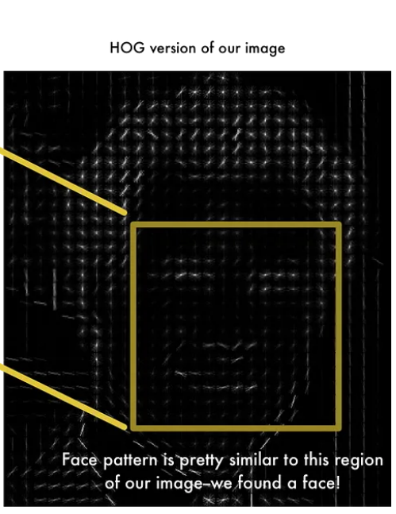

Slide 23
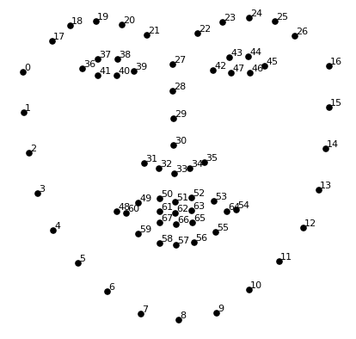
Pose Normalization with Landmarks
Locate 68 face landmarks using landmark estimation.
Adjust image rotation, scale, and shear to center eyes and mouth consistently.
Affine transformations preserve parallel lines, aiding accuracy in the next steps.

Slide 24
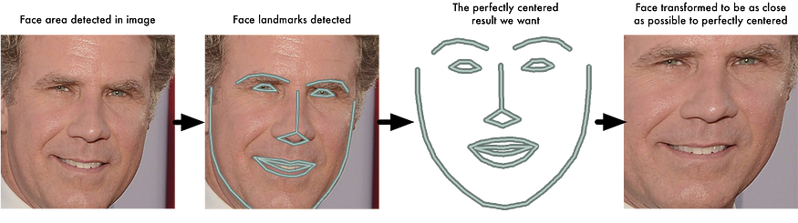

Slide 25
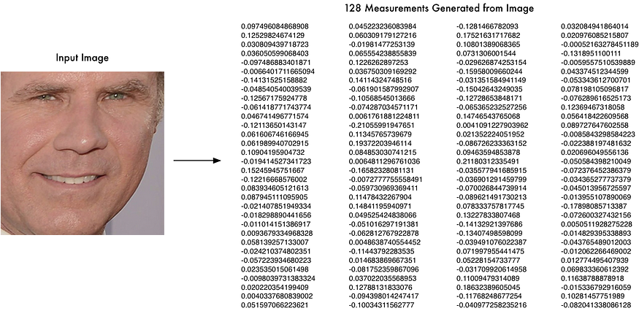
Face Encoding with Deep Learning
Train a Deep Convolutional Neural Network to generate 128 measurements (embedding) for each face.
Use triplets of images (two of the same person, one of a different person) to optimize network parameters.
Embeddings serve as unique representations, capturing facial features in a computer-readable format.

Slide 26
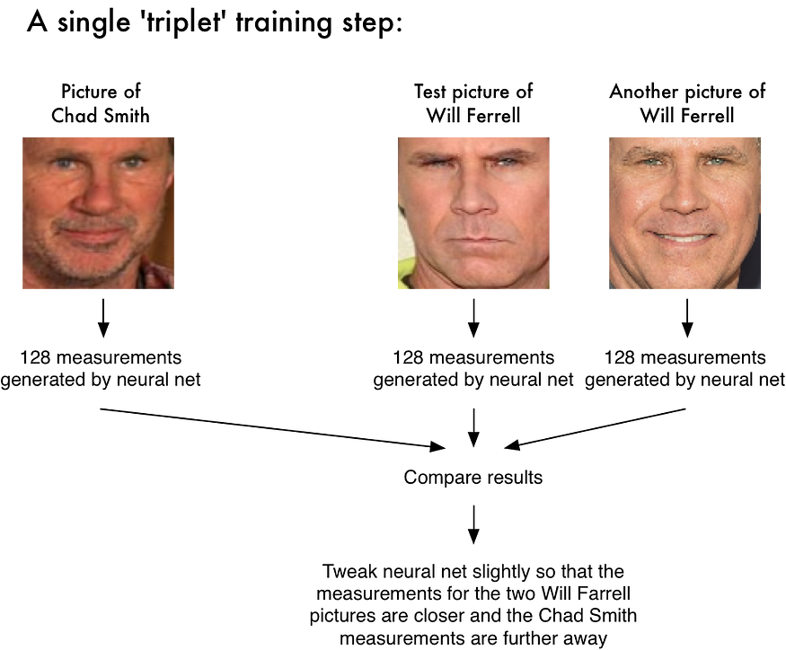

Slide 27
Matching and Classification
Create a database of known individuals with their corresponding embeddings.
Employ a simple linear Support Vector Machine (SVM) classifier for matching.
Find the person with the closest measurements to the test image, resulting in the identified name.

Slide 28
Summary
The project aims to enhance attendance tracking through a cutting-edge face recognition system. It incorporates features like a face database, automatic face location, and Python integration. The installation process is well-documented, ensuring seamless deployment. Troubleshooting support addresses common issues for widespread applicability.
Thank-You!!

